Slide 1
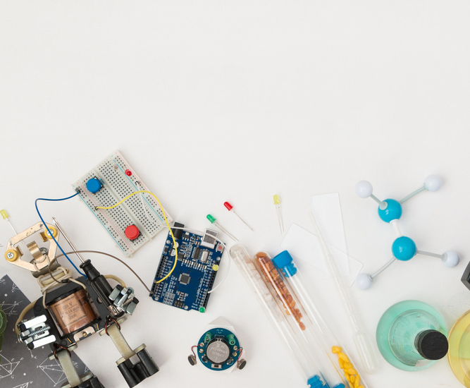
FACULTY OF MEDICINE
DATE
Chulalongkorn University
17/09/2025
AI ENGINEERING
Infra basics & AI Product Lifecycle
From model training to real-world healthcare deployment
PRESENTED BY
Karin Huangsuwan,
AI Solution Consultant
4Plus Consulting Co., Ltd.

Slide 2



WHY AI ENGINEERING?
Training a model = 1 step, but deployment needs more.
Accessible
Reliable
Safe
01
02
03
2

Slide 3

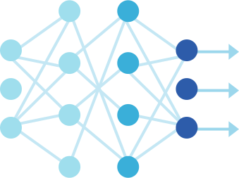


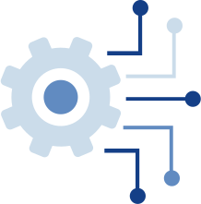
AI APPLICATION INFRASTRUCTURE
Chatbots, Predictive Analytics, Recommenders
APPLICATIONS
Pretrained models, fine-tuned models
MODELS
Data pipelines, storage, ETL, feature stores
DATA
GPUs/TPUs, cloud infrastructure, orchestration
COMPUTE
Monitoring, CI/CD for ML, deployment pipelines
MLOps
3

Slide 4
AI APPLICATION INFRASTRUCTURE
APPLICATIONS
Chatbots, Predictive Analytics, Recommenders
What the user sees, but powered by deep infrastructure
Must integrate seamlessly with business workflows
MODELS
Pretrained models, fine-tuned models
Need retraining & fine-tuning for changing data distributions
Risk of model drift; requires periodic validation
DATA
Data pipelines, storage, ETL, feature stores
Data quality is the bottleneck; 80% of ML work is data prep
Handling unstructured data (text, images, logs) at scale
4

Slide 5
AI APPLICATION INFRASTRUCTURE
COMPUTE
GPUs/TPUs, cloud infrastructure, orchestration
Training large models is compute-bound, requiring scaling strategies
Optimize cost with hybrid/on-demand cloud
MLOps
Monitoring, CI/CD for ML, deployment pipelines
Keeps models reliable post-deployment, ensures reproducibility
Automate monitoring & retraining to avoid “silent failures”
5

Slide 6
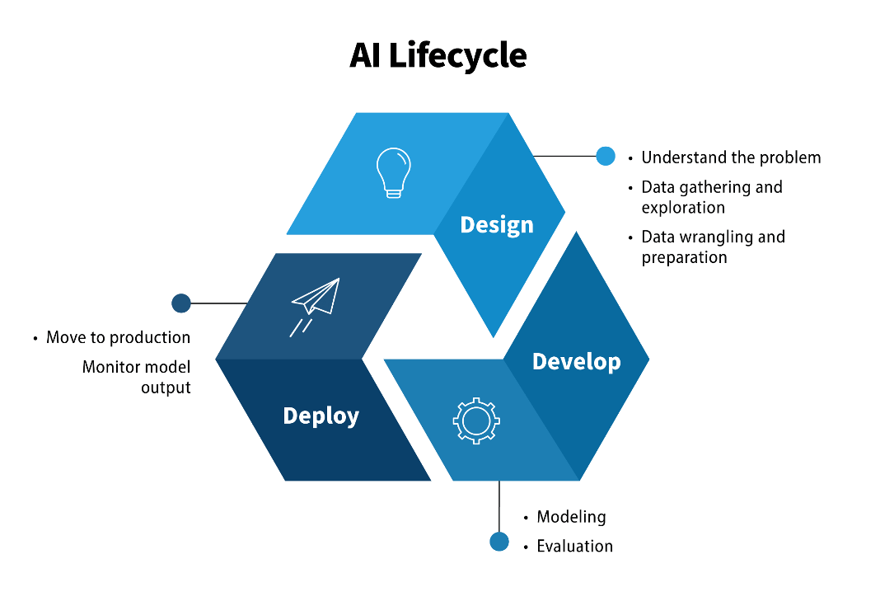
THE AI PRODUCT LIFECYCLE
6
https://coe.gsa.gov/coe/ai-guide-for-government/understanding-managing-ai-lifecycle/

Slide 7



DESIGN
Shape the foundation for AI solutions
Understand the Problem
Define business objectives & success criteria.
Confirm problem is suitable for AI.
Data Gathering & Exploration
Identify available datasets, check quality.
Plan how to access, store, and use data.
Data Wrangling & Preparation
Clean and transform raw data into usable formats.
Handle missing values, normalization, feature creation.
7

Slide 8


DEVELOP
Build and validate the AI system
Modeling
Experiment with different algorithms.
Train, test, refine — expect multiple iterations.
Ensure infrastructure supports compute needs.
Evaluation
Use relevant metrics (accuracy, fairness, bias).
Test with unseen data to ensure generalization.
Confirm the model meets business objectives.
8

Slide 9
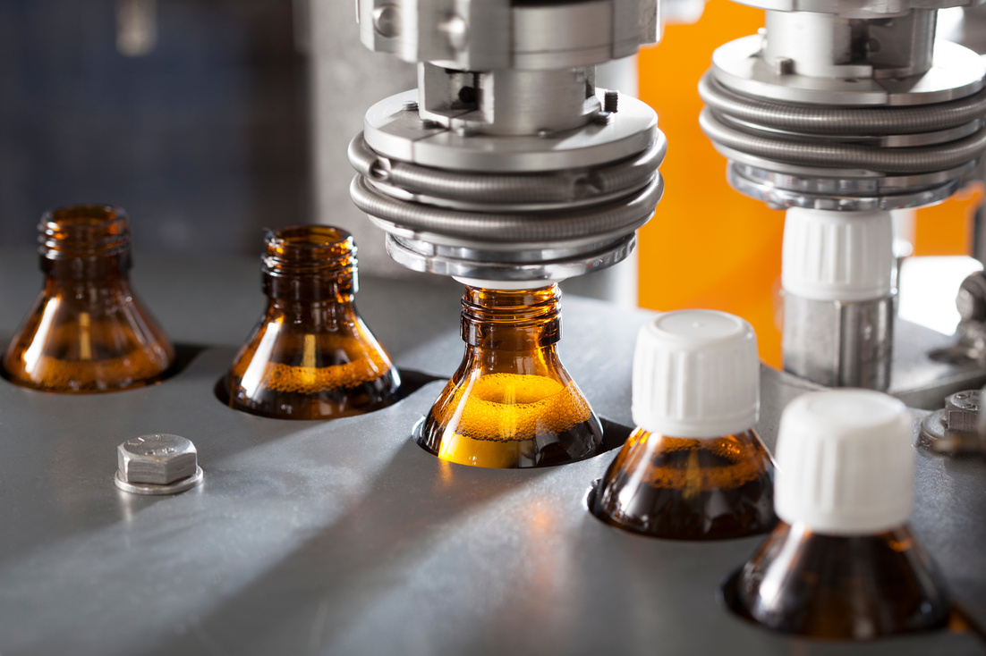

DEPLOY
Deliver real-world value and maintain performance
Production Transition
Move best-performing model into live environment.
Handle new and unseen input data effectively.
Monitoring & Maintenance
Track outputs for drift, bias, and errors.
Continuously update and retrain models as needed.
Apply agile, iterative improvements.
9

Slide 10
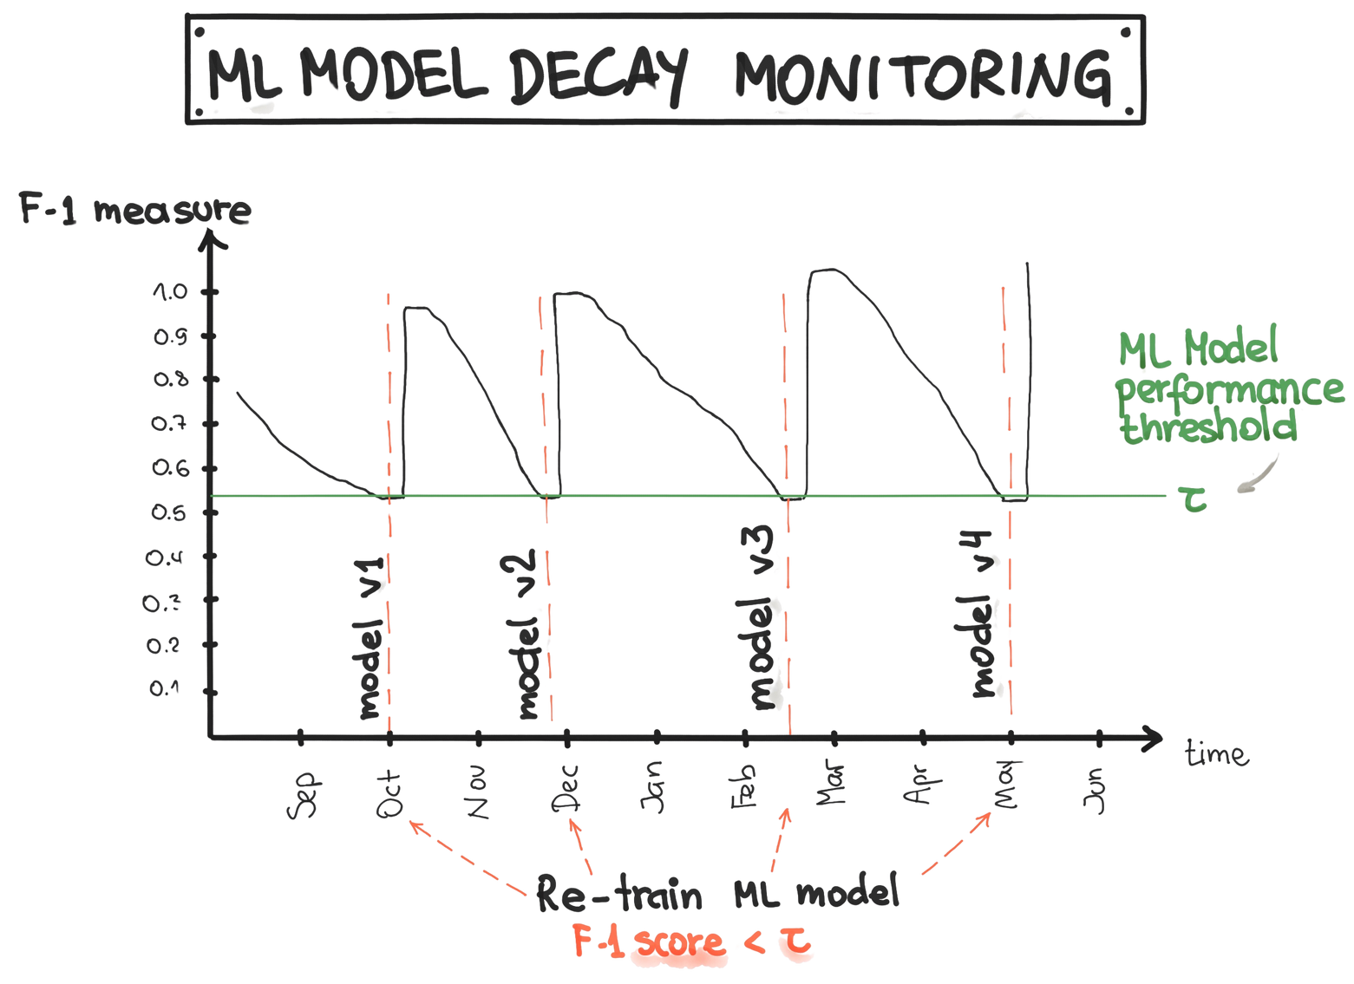
WHY RETRAIN?
Model performance decays over time: an ML model’s accuracy (F1 score) gradually drops as data changes.
Threshold for action: When performance falls below a set limit (τ), it’s like vitals crossing a danger zone — intervention is needed.
Retraining as treatment: Retraining the model restores performance, similar to giving another dose of medication to bring levels back up.
10
https://ml-ops.org/content/mlops-principles

Slide 11


DEPLOYMENT TOOL: FastAPI
What is FastAPI?
A tool to turn ideas into apps quickly.
Lets developers create simple websites or services that computers can talk to.
Comes with a “self-explanatory manual” (automatic docs).
Why it’s Useful
Fast → Makes apps respond quickly.
Easy → Fewer steps to go from idea → working app.
Ready to Share → Runs smoothly on cloud platforms (AWS, Google, Azure).
Scalable → Can grow from small demo to full business service.
11

Slide 12


MONITORING & RETRAINING TOOL: MLFlow
What is MLflow?
A tool to keep track of machine learning projects.
Think of it as a “control center” for experiments, models, and results.
Helps teams organize, compare, and share their work.
Why it’s Useful
Tracks Experiments → Keeps a record of what worked and what didn’t.
Manages Models → Stores different versions safely.
Easy Deployment → Push models into apps or services with less hassle.
Collaboration → Teams can work together without losing progress.
12

Slide 13
Conclusion
AI Engineering = more than training → it’s about deploying, monitoring, and evolving
Lifecycle (Design → Develop → Deploy) keeps AI reliable and valuable
Tools like FastAPI & MLflow make AI practical, scalable, and sustainable
Goal: Deliver accessible, reliable, safe AI that adapts to real-world change
13

